Slide 1

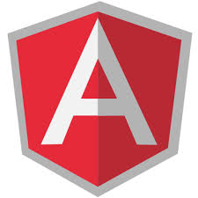

Leveraging technology to Power Enterprise Efficiency
Introduction to AngularJS
Prepared by: Dharmesh G Baraskar
www.doyen.co.in

Slide 2
Leveraging technology to Power Enterprise Efficiency
Agenda
Introduction.
Why use it?
Getting Started- General Feature.
Directives Filters & Data Binding.
View, Controller, Model & Scope.
Modules, Routes and Factory.
Integrate with MVC Asp.net.
Some Comparison scripting library with Angular JS.
Pros and Cons.
www.doyen.co.in

Slide 3
Leveraging technology to Power Enterprise Efficiency
Introduction
Introduction
Angular JS is a very powerful structural Framework .It is used as a extension of HTML markup tags like as a attribute ,directive and as a tag element that make it more responsible to user action.
AngularJS -Open Source Free Of Charge
License – MIT
Originally Developed in 2009 by AngularJS was originally developed in 2009 by Misko Hevery and Adam Abrons in Brat Tech LLC, Google and community.
AngularJS's design goals include:
Decouple DOM manipulation from application logic. This improves the testability of the code.
Angular implements the MVC pattern to separate presentation, data, and logic components. Using dependency injection, Angular brings traditionally server-side services, such as view-dependent controllers, to client-side web applications. Consequently, much of the burden on the server can be reduced.
Bootstrapper The tasks performed by the AngularJS bootstrapper occur in three phases[6] after the DOM has been loaded:
Creation of a new Injector
Compilation of the directives that decorate the DOM
Linking of all directives to scope.
Angular JS is a very powerful structural Framework .It is used as a extension of HTML markup tags like as a attribute ,directive and as a tag element that make it more responsible to user action.
AngularJS -Open Source Free Of Charge
License – MIT
Originally Developed in 2009 by Misko Hevery and Adam Abrons in Brat Tech LLC, Google and community.
AngularJS's design goals include:
Decouple DOM manipulation from application logic. This improves the testability of the code.
Angular implements the MVC pattern to separate presentation, data, and logic components. Using dependency injection, Angular brings traditionally server-side services, such as view-dependent controllers, to client-side web applications. Consequently, much of the burden on the server can be reduced.
Boots-trapper The tasks performed by the AngularJS boots-trapper occur in three phases after the DOM has been loaded:
Creation of a new Injector
Compilation of the directives that decorate the DOM
Linking of all directives to scope.

Slide 4
Leveraging technology to Power Enterprise Efficiency
Why use It ?
The problem – HTML is great for static pages, but has no tools for web applications
The solution – extend and adapt HTML vocabulary with some additional declarations that are useful for web applications.
More efficiency in development
Separation of concerns.
Uses JQLite (a subset of JQuery) for DOM manipulations
If you include jQuery before Angular, it will be used instead of JQLite
MVC = Model-View-Controller
Less dependencies
Improves maintainability
It is easier to read and understand code
www.doyen.co.in

Slide 5
Leveraging technology to Power Enterprise Efficiency
General Feature-Getting Started
AngularJS directives allow the developer to specify custom and reusable HTML-like elements and attributes that define data bindings and the behavior of presentation components.
Some of the most commonly used directives are:
ng-app or data-ng-da
Declares the root element of an AngularJS application, under which directives can be used
to declare bindings and define behavior.For example: in place of ng-app you can use
<html ng-app=””> or you can use <div ng-app=””></div>
ng-bind
Sets the text of a DOM element to the value of an expression.
For example, <span ng-bind="name"></span>
will display the value of ‘name’ inside the span element. Any changes to the variable ‘name’ in
the application's scope are reflected instantly in the DOM.
ng-model
Similar to ng-bind, but establishes a two-way data binding between the view and the scope.
<input type=”text” ng-model=”Name”/>
ng-model-options
Allows tuning how model updates are done.
ng-class
Allows class attributes to be dynamically loaded.
www.doyen.co.in

Slide 6
Leveraging technology to Power Enterprise Efficiency
ng-controller
Specifies a JavaScript controller class that evaluates HTML expressions.
ng-repeat
Instantiate an element once per item from a collection.
ng-show & ng-hide
Conditionally show or hide an element, depending on the value of a boolean expression. Show and hide is achieved by setting the CSS display style.
ng-switch
Conditionally instantiate one template from a set of choices, depending on the value of a selection expression.
ng-view
The base directive responsible for handling routes that resolve JSON before rendering templates driven by specified controllers.
ng-if
Basic if statement directive which allow to show the following element if the conditions are true. When the condition is false, the element is removed from the DOM. When true, a clone of the compiled element is re-inserted
ng-aria
A module for accessibility support of common ARIA attributes.
www.doyen.co.in

Slide 7
Leveraging technology to Power Enterprise Efficiency
Directive,Filter & Data-Binding
Directive:
Use them when you have to make DOM manipulations.
Ever wanted to create your own tag or attribute – this is how you do it!.
Takes you one step closer to creating domain-specific markup.
Directives should not change a model or controller’s logic.
All they handle is creating the page’s content and structure of elements.
Filter:
Reusable operation using which you can modify the content that is shown on the page
Examples: uppercase a value, filter search results, etc
module.filter(“filter_name”, function(data) {
// data is filtered or modified
// in a specific manner and returned
return data;
}
www.doyen.co.in

Slide 8
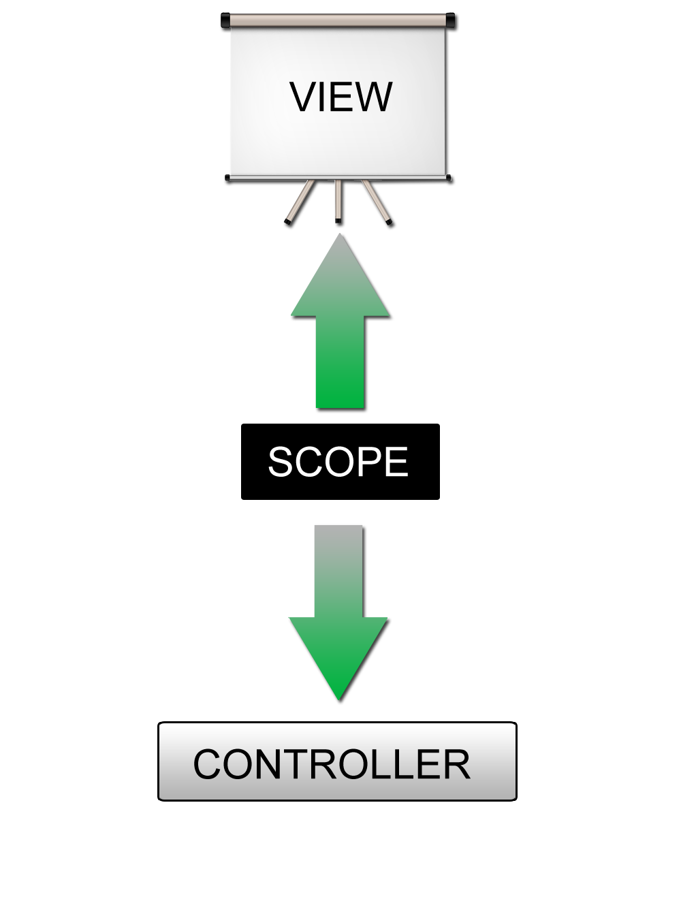
Leveraging technology to Power Enterprise Efficiency
Bindings:
(Two way data binding ng - model & one way binding using ng - bind)
View is updated automatically when the Model is changed
Model is updated automatically when a value in the View has changed
No DOM manipulation needed!
On ng- bind in one way view change update the model.
www.doyen.co.in

Slide 9
Leveraging technology to Power Enterprise Efficiency
View, Controller, Model & Scope
MVC = Model-View-Controller
Less dependencies
Improves maintainability
It is easier to read and understand code
M for Model : -
Holds the data.
Notifies the View and the Controller for changes in the data.
Does not know about the View and the Controller.
V for View: -
Displays stuff (buttons, labels, …)
This is what your users will see
Knows about the Model
Usually displays something related to the current state of the Model.
C for Controller: -
Controls everything
Knows about both the Model and the View
The “logic” resides in it
What to happen, when and how
www.doyen.co.in
www.doyen.co.in

Slide 10
Modules, Routes and Providers:
Module :
Each Angular JS app contains at least one module
Discrete logical part of the application
Module is container for
Controllers
Services
Directives
Factories
Filters
Configuration information
Routes:
if you have different views and those views need to be loaded into the shell page then we need a way to be able to track what route we’re on and what view that’s associated with and then what controller goes with that view and how we do all of that.
When you define a route in AngularJS you can define two things
One of those is the view. So what view when that route such as “unit.org/orders” then maybe go to “orderspartial.html” or “ordersfragment.html”

Slide 11
Leveraging technology to Power Enterprise Efficiency
Module
Config
Routes
View
$scope
Controller
Directive
Factory
www.doyen.co.in

Slide 12
Leveraging technology to Power Enterprise Efficiency
Leveraging technology to Power Enterprise Efficiency
angular.module('ngViewExample', ['ngRoute', 'ngAnimate'])
.config(['$routeProvider', '$locationProvider',
function($routeProvider, $locationProvider) {
$routeProvider
.when('/Book/:bookId', {
templateUrl: 'book.html',
controller: 'BookCtrl',
controllerAs: 'book'
})
.when('/Book/:bookId/ch/:chapterId', {
templateUrl: 'chapter.html',
controller: 'ChapterCtrl',
controllerAs: 'chapter'
});
$locationProvider.html5Mode(true);
}])
www.doyen.co.in
www.doyen.co.in

Slide 13
Leveraging technology to Power Enterprise Efficiency
Provider
4 types of providers
Factory
Service
Value
Provide
Providers – Factory:
We define a function that returns an object to which we have attached methods and properties that will be accessible by factory users later
This object is available everywhere in the module in which the factory was defined via Dependency Injection.
Defining the factory:
module.factory(‘factory_id’, function() {
return {
functionname: function() {return “this is a function”;},
anotherfunction: function() { // make a request and get data from backend
return data;}}});
www.doyen.co.in

Slide 14
Leveraging technology to Power Enterprise Efficiency
Service
Angular service are substitute object that are wired together using dependency injection .
You can use your service to organize and share code across your app.
Angular service are :
Lazy instantiated: - angular instance a service when an application dependance on it.
Singleton: - each component dependance on a service gets a reference to the singleton instance generated by the service function.
You define a function in which additional functions and properties are defined via the this keyword
module.service(‘service_name’, function() {
this.function_name = function() {
return “this is a function’s result”; };
this.anotherfunction = function() {
// make a request to backend
// and fetch data
return data;});
Module.controller(‘ControllerName’, function ControllerName($scope, service_name) {
$scope.methodname = function() {
service_name.function_name();}});
www.doyen.co.in

Slide 15
Leveraging technology to Power Enterprise Efficiency
Value
Similar to constants
Could be used to store configuration properties
module.value(‘value_name’, ‘value’);
Module.controller(‘ControllerName’, function ControllerName($scope, service_name) {
$scope.methodname = function() {
service_name.function_name();
}
});
Module.controller(‘ControllerName’, function ControllerName($scope, value_name) {
$scope.methodname = function() {
if (value_name == ‘1’) {
// do something based on
// specific value of the constant
}
}
});
www.doyen.co.in

Slide 16
Leveraging technology to Power Enterprise Efficiency
Provider
Define $get method in a function that returns the object to be injected
The object can have various properties and methods similar to the object returned by factory
module.provider(‘provider_name’, function() {
this.$get = function() {
return {
function_name: function() {
},
another_function: function() {
}
}
});
Module.controller(‘ControllerName’, function ControllerName($scope, provider_name) {
$scope.methodname = function() {
provider_name.function_name();
}
});
www.doyen.co.in

Slide 17
Leveraging technology to Power Enterprise Efficiency
Integrate with Asp.net. MVC
Using example
www.doyen.co.in

Slide 18
Leveraging technology to Power Enterprise Efficiency
Some Comparison scripting library with Angular JS.
KnockoutJS vs AngularJS
Templating
Angular and Knockout both provide DOM based template ting.
Angular only supports HTML as its template ting mechanism.
Knockout by default uses HTML as its templating mechanism ( which is where they both have DOM based templating ) , but Knockout also supports other string based templating engines like Handlebars etc.
Context
In knockout, in order to fetch data from a context that is in the parent of your current context, you need to access it using `$parent`.
In angular, context’s inherit prototypically. So, to access something from the parent context, you don't usually have to use $parent . You only need to use $parent if you have another variable with the same name defined in your current context as well.
www.doyen.co.in

Slide 19
Leveraging technology to Power Enterprise Efficiency
Directives or Custom Bindings
Angular has directives. You can define custom elements, custom attributes, comments and classes.
Knockout doesn't allow you to create custom elements. You have to create all your bindings inside data-bind
JQuery Dependency
Angular has its own version of JQuery called JQuery Lite ( smaller jQuery). If you include JQuery before Angular, it will use the JQuery you loaded.
Knockout does not depend on JQuery or create its own version of it. But, having said that, Knockout is a data-binding library. It does not have any opinions or implementations for doing Ajax or DOM querying. If you don’t include JQuery, you are free to do Ajax and DOM manipulation either directly or with some other library.
Browser support
Angular supports all new browsers and its support goes back till IE8.
Knockout supports till IE6.
www.doyen.co.in

Slide 20
Leveraging technology to Power Enterprise Efficiency
Variable Observation
Angular observes variables using a technique called as dirty checking. On the other hand, Knockout uses the Observable pattern. In terms of code
Angular HTML :
<div ng-bind="myContent"></div>
or
<div>{{myContent}}</div>
Angular javascript :
$scope.myContent = "Hello World";
Knockout HTML :
<div data-bind="text : myContent"></div>
Knockout Javascript :
var myContent = ko.observable("Hello World");
www.doyen.co.in

Slide 21
Leveraging technology to Power Enterprise Efficiency
To change this content..
In Angular :
$scope.myContent = "Hello You";
In Knockout :
myContent("Hello You")
Events and custom parameter passing :
Angular HTML
<button data-ng-click="onButtonClick($event,'save')">Save</button>
<button data-ng-click="onButtonClick($event,'cancel')">Cancel</button>
Angular Javascript
$scope.onButtonClick = function(event,action){
// your code.
};
Knockout HTML
<button data-bind="click : onButtonClick.bind($root,'save')">Save</button>
<button data-bind="click : onButtonClick.bind($root,'cancel')">Cancel</button>
or
<button data-bind="click: function(data, event) { onButtonClick('save',data, event) }">Save</button>
<button data-bind="click: function(data, event) { onButtonClick('cancel',data, event) }">Cancel</button>
www.doyen.co.in

Slide 22
Leveraging technology to Power Enterprise Efficiency
Angular Expressions vs. JavaScript Expressions
Angular expressions are like JavaScript expressions with the following differences:
Context: JavaScript expressions are evaluated against the global window. In Angular, expressions are evaluated against a scope object.
Forgiving: In JavaScript, trying to evaluate undefined properties generates Reference-error or Type-error In Angular, expression evaluation is forgiving to undefined and null.
No Control Flow Statements: You cannot use the following in an Angular expression: conditionals, loops, or exceptions.
No Function Declarations: You cannot declare functions in an Angular expression, even inside ng-init directive.
No RegExp Creation With Literal Notation: You cannot create regular expressions in an Angular expression.
No Comma And Void Operators: You cannot use , or void in an Angular expression.
Filters: You can use filters within expressions to format data before displaying it.
If you want to run more complex JavaScript code, you should make it a controller method and call the method from your view. If you want to eval() an Angular expression yourself, use the $eval() method.
www.doyen.co.in

Slide 23
Leveraging technology to Power Enterprise Efficiency
Pros and Cons
AngularJS is an open source framework of JavaScript that strives to make single-page applications run with ease and success. It uses the Model-View-Controller (MVC) utility to improve browser-based web applications. AngularJS has been regarded by many as a next generation tool that tries to integrate a number of functionality and work in an interconnected manner. There are two principles that largely guide the working of AngularJS. It believes that declarative programming should be solely used for designing user interface and imperative programming should be left for establishing domain logic. Operating on the basis of these two principles and loaded with a bunch of exceptional features, AngularJS framework displays a lot of good points. Some of them are as
follows
MVC capability: AngularJS does not require writing lengthy codes to connect the MVC components of split apps, which saves oodles of time and effort. Just split the app and let Angular do the rest for you by managing the components and also connecting them all by itself.
Two-way data binding: AngularJS comes with this great feature which reduces writing codes substantially. Data binding tries to get rid of writing codes manually by relieving the back end server from creating templates. MVC pipeline is also maintained by the framework itself.
www.doyen.co.in

Slide 24
Leveraging technology to Power Enterprise Efficiency
Directives: Angular Directives add more functionality to the simple HTML. Directives help to enable the developer to specify custom and reusable HTML tags that change the behavior of some elements. Some directives featured in AngularJS are ng-app, ng-bind, ng-controller, ng-switch, ng-view, etc.
DOM manipulations: AngularJS keeps DOM manipulation codes inside the directives and not in the view. This augments in generating a clean and clear user interface.
Test-ready: The fact that AngularJS comes linked with Dependency Injection (DI) makes it ready for unit testing by injecting mock data into controller and measuring the output and behavior.
However, AngularJS is not all perfect. A couple of not-so-great aspects of AngularJS are:
Difficult to adapt the existing code: AngularJS requires the developer to re-implement the entire transformation code which makes it extremely hard to play around while adapting existing code.
Too heavy: AngularJS is a bulky framework that might be a good option to build large applications. But in case of simpler requirements of data binding, it can get a little too much to deal with and could confuse you with an excess of functionality that might be totally useless. Lighter frameworks like KnockoutJS or BackboneJS might be a better option in such a situation.
www.doyen.co.in

Slide 25
Leveraging technology to Power Enterprise Efficiency
Thank You
www.doyen.co.in

Slide 26
Leveraging technology to Power Enterprise Efficiency
Reference:
http://blog.nebithi.com/knockoutjs-vs-angularjs/
https://thinkster.io/a-better-way-to-learn-angularjs/
https://docs.angularjs.org/api
https://www.youtube.com/watch?v=WqmeI5fZcho
http://weblogs.asp.net/dwahlin/the-angularjs-jumpstart-video-training-course-has-been-released
www.doyen.co.in

